Slide 1
How was your MAP® experience?
As you get settled, tell us about your MAP experience.
Please add comments or questions to the graffiti wall. Use the sticky notes on the tables.
Notes:
Timing: Before the workshop, as people are entering.
Purpose:
Display as a warm-up activity as participants arrive. Ask participants to share their comments and questions regarding MAP.
Facilitator Notes:
Use sticky notes: one color for comments, another color for questions.

Slide 2
Stepping Stones to Using Data Web-Based MAP
Measures of Academic Progress, MAP, DesCartes: A Continuum of Learning, Partnering to help all kids learn, Power of Instructional Design, Power of Teaching, Power of Coaching, Keeping Learning on Track, and Learning Plans on Demand are registered trademarks of NWEA in the U.S. and in other countries. Northwest Evaluation Association, NWEA, GRD, KLT, Skills Pointer, Children’s Progress Academic Assessment, and CPAA are trademarks of NWEA in the U.S. and in other countries.
Lexile® is a trademark of MetaMetrics, Inc., and is registered in the United States and abroad.
The names of other companies and their products mentioned are the trademarks of their respective owners.
Notes:
Timing: Slides 2 and 3, 10 minutes total; 5 minutes for introductions and structure of the day on the next slide.
Purpose:
Display this slide during introductions.

Slide 3
Setting the Stage
Welcome and introductions
Structure for the day
Agenda
Notes:
Timing: Slides 2 and 3, 10 minutes total; continue 5 minutes for introductions and structure of the day from previous slide; 5 minutes for agenda
Purpose:
Display this slide during discussion of structure of the day and agenda.

Slide 4
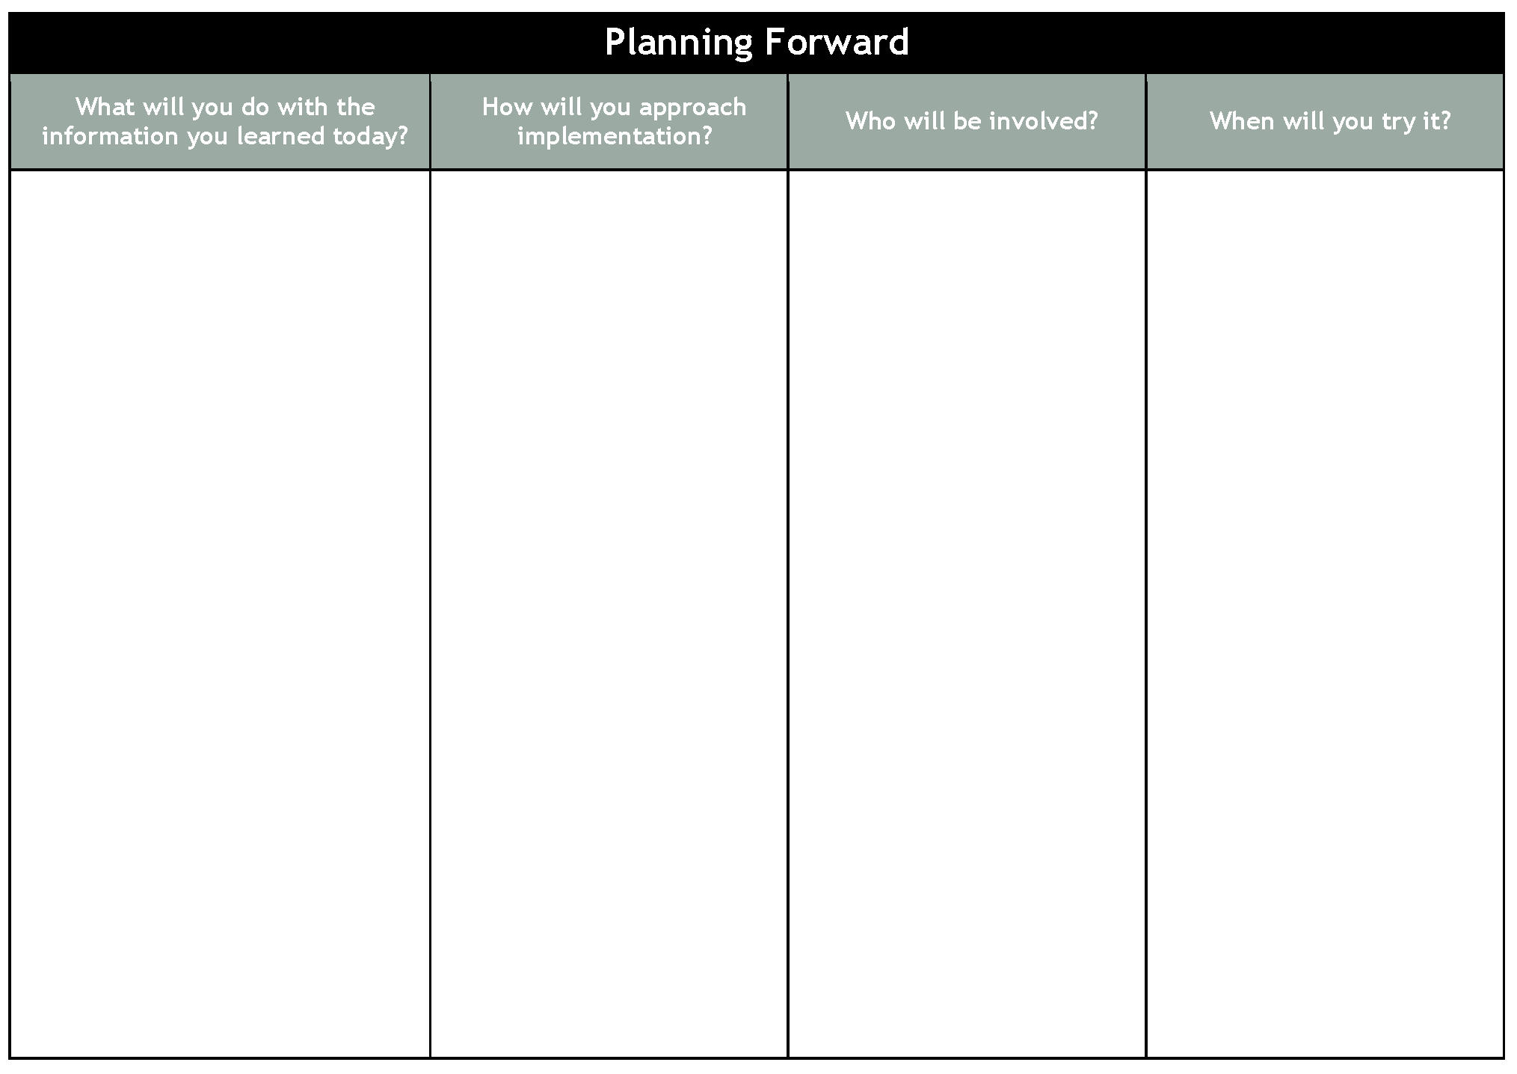
Planning Forward
Notes:
Timing: 5 minutes
Purpose:
Introduce the Planning Forward document as an action-planning document to capture ideas throughout the day.

Slide 5
Self-Assessment
I am aware | I understand | I can apply | I can teach others
DesCartes: A Continuum of Learning®/Primary Grades Instructional Data (PGID) for lesson planning and goal setting.
The Class Breakdown by Goal Report for lesson planning and grouping.
The Class Report to make instructional decisions.
Identify strengths and areas of need using MAP data.
How to access and understand growth projections for students.
Set goals with my classes and students.
Notes:
Timing: 15 minutes
Purpose:
Participants self-assess and report their skill level for reference at the end of the day.

Slide 6
Activating Prior Knowledge
Adaptive Assessment
RIT Scale as a Growth Measure
Normative Data
Instructional Readiness
DesCartes: A Continuum of Learning
Primary Grades Instructional Data
Notes:
Timing: 15 minutes
Purpose:
Participants recall information from previous workshops or experience as a foundation for additional learning.
Links:
Adaptive Assessment: slide 26
RIT Scale as a Growth Measure: slides 27-28
Normative Data: slides 29-30
Instructional Readiness: slides 31-33
DesCartes: A Continuum of Learning: slide 33
Primary Grades Instructional Data: slide 34

Slide 7
Class Report
Displays the teacher’s class data for the current testing term, by RIT score
Notes:
Essential Reports Chart
Timing: 5 minutes
Purpose:
Note-taking device for participants
Exploring the Class Report
Timing: 15 minutes
Purpose:
Participants access, interpret, and apply data from the Class Report

Slide 8
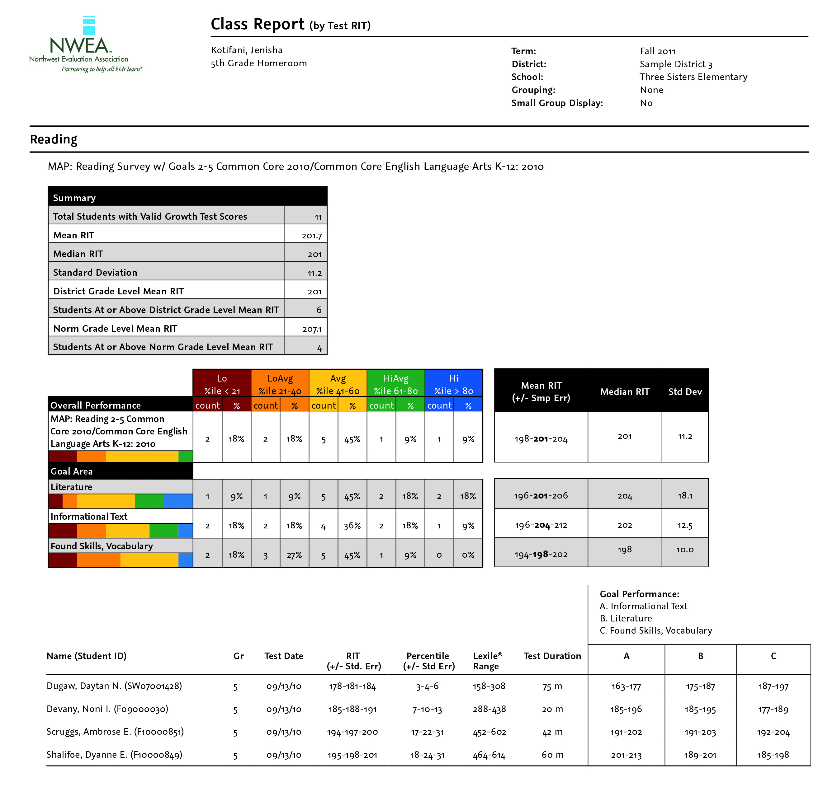
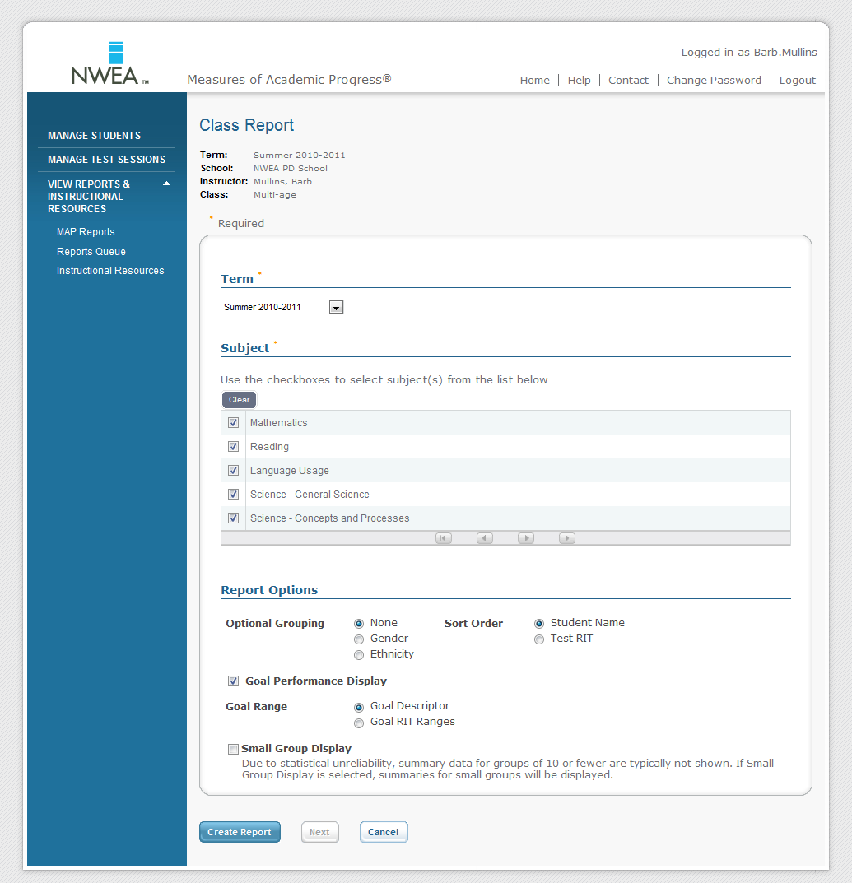
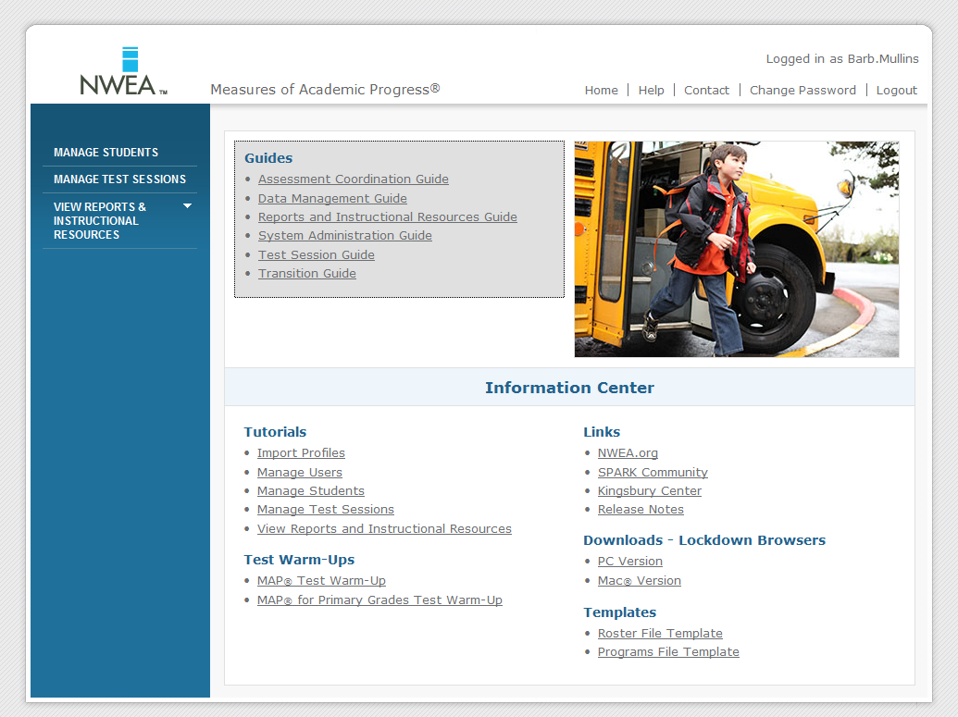
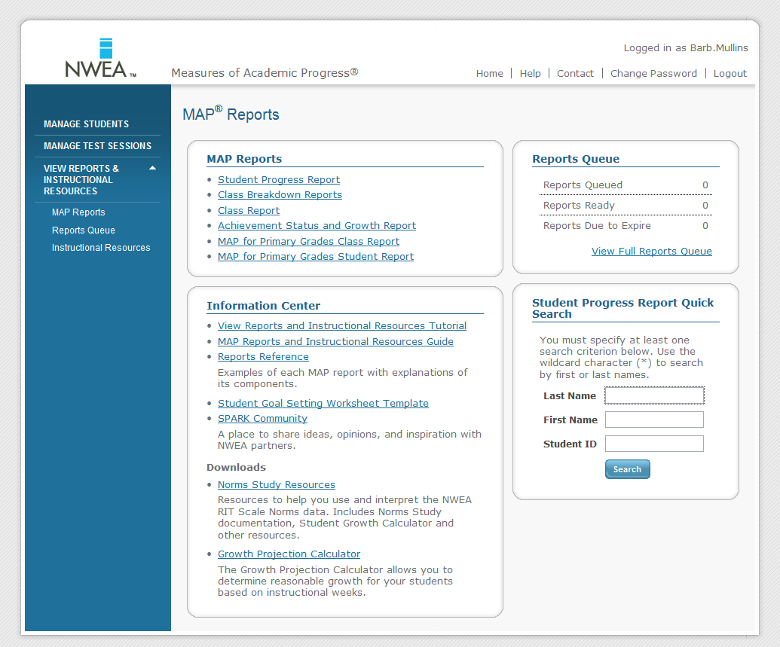
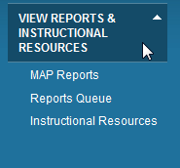
Accessing the Class Report
Notes:
Exploring the Class Report, continued from slide 7
Timing: 15 minutes
Purpose:
Participants access, interpret, and apply data from the Class Report
Timing: 25 minutes
Purpose:
Analyze the Class Reports using Activities Packet as a guide

Slide 9
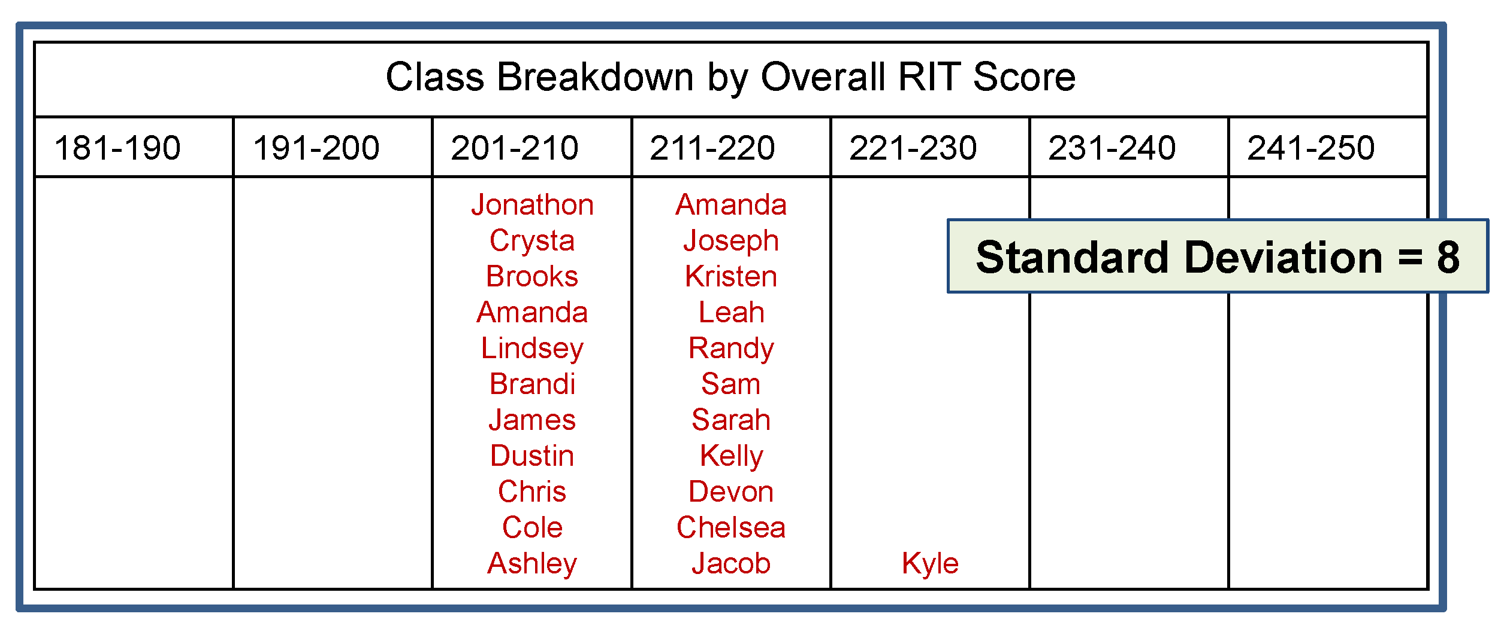
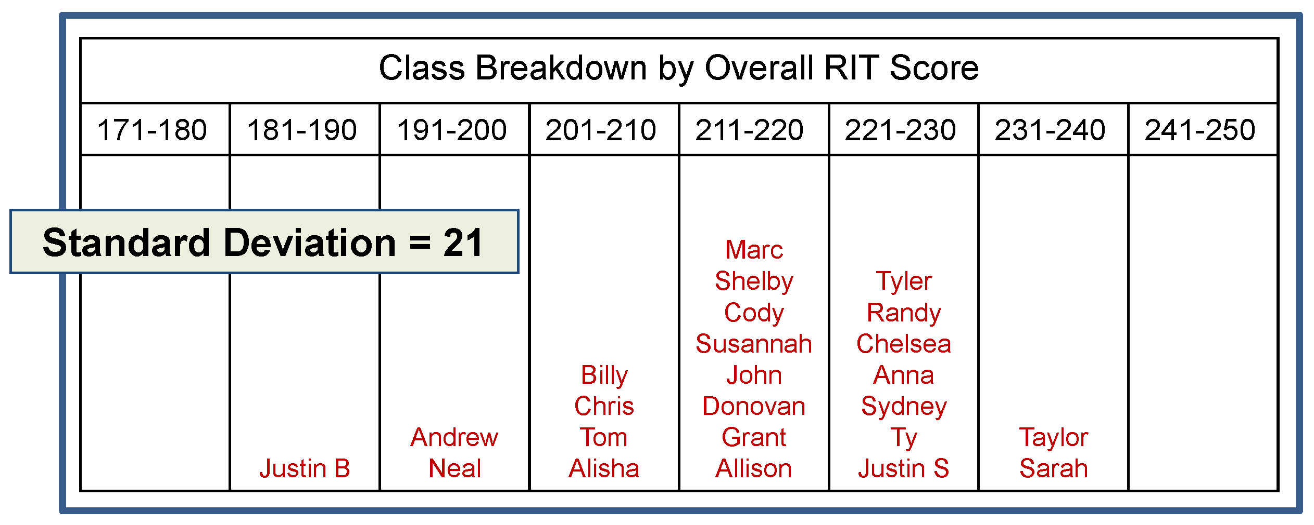
Standard Deviation
Smaller standard deviations indicate that students are more alike.
How might this impact instruction?
Larger standard deviation indicates more academic diversity
How might this impact instruction?
Notes:
Timing: Use if questions arise about standard deviation
Purpose:
Show a visual representation of standard deviation
Consensogram (no slide for this; use chart paper)
Timing: 15 minutes
Purpose:
Participants identify trends and patterns in data using their Class Reports

Slide 10
Class Breakdown by RIT Reports
Displays the teacher’s class data by subject and horizontally by RIT for current test term.
Notes:
Timing: 10 minutes (of 45)
Purpose:
Participants explore annotated Class Breakdown by RIT and Class Breakdown by Goal reports.

Slide 11
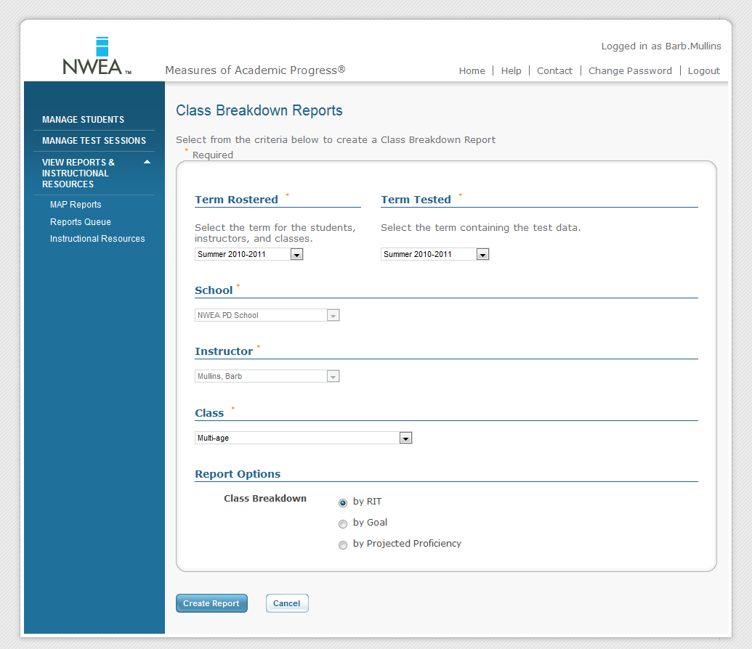
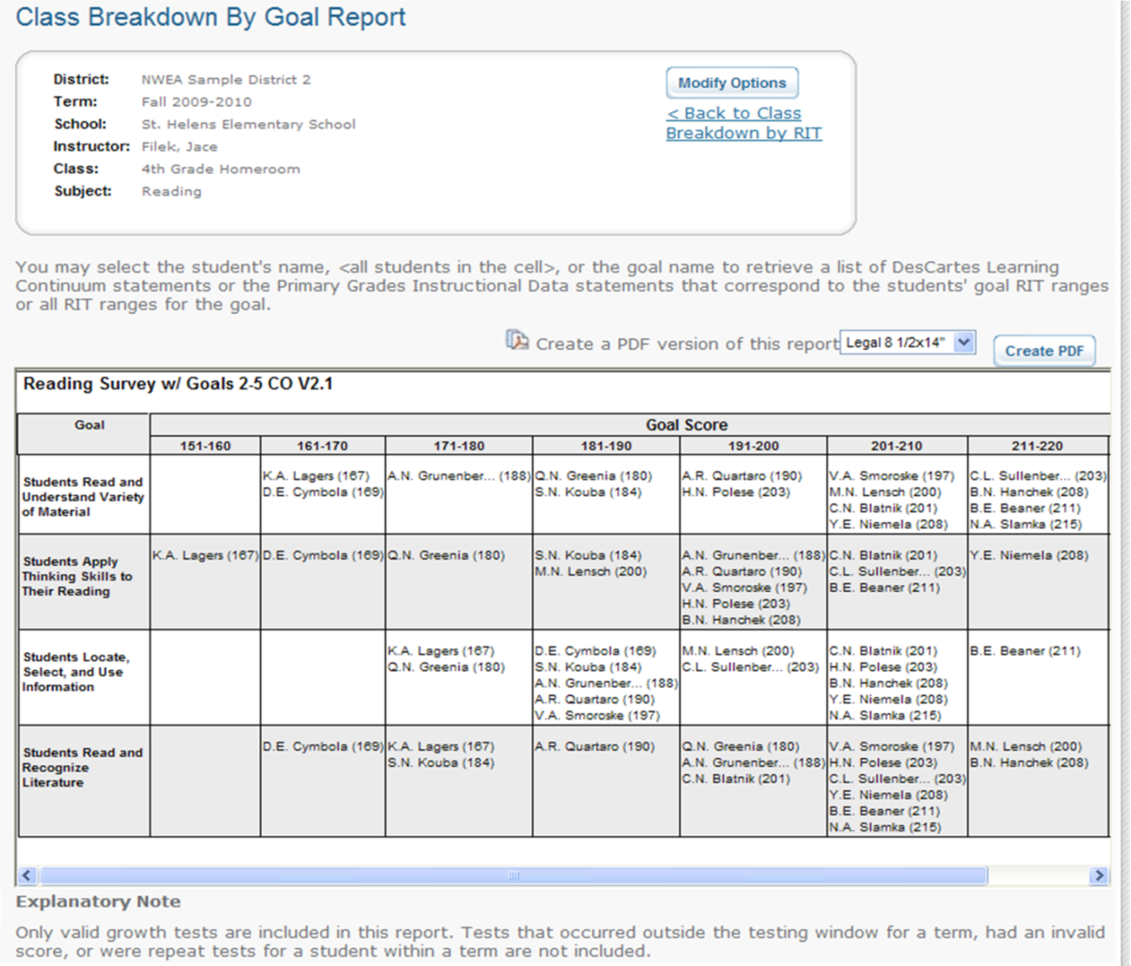
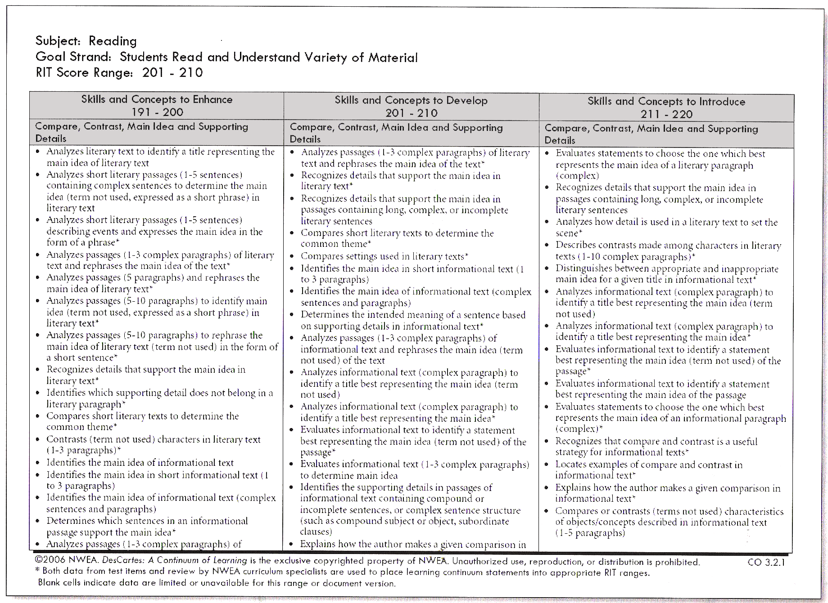
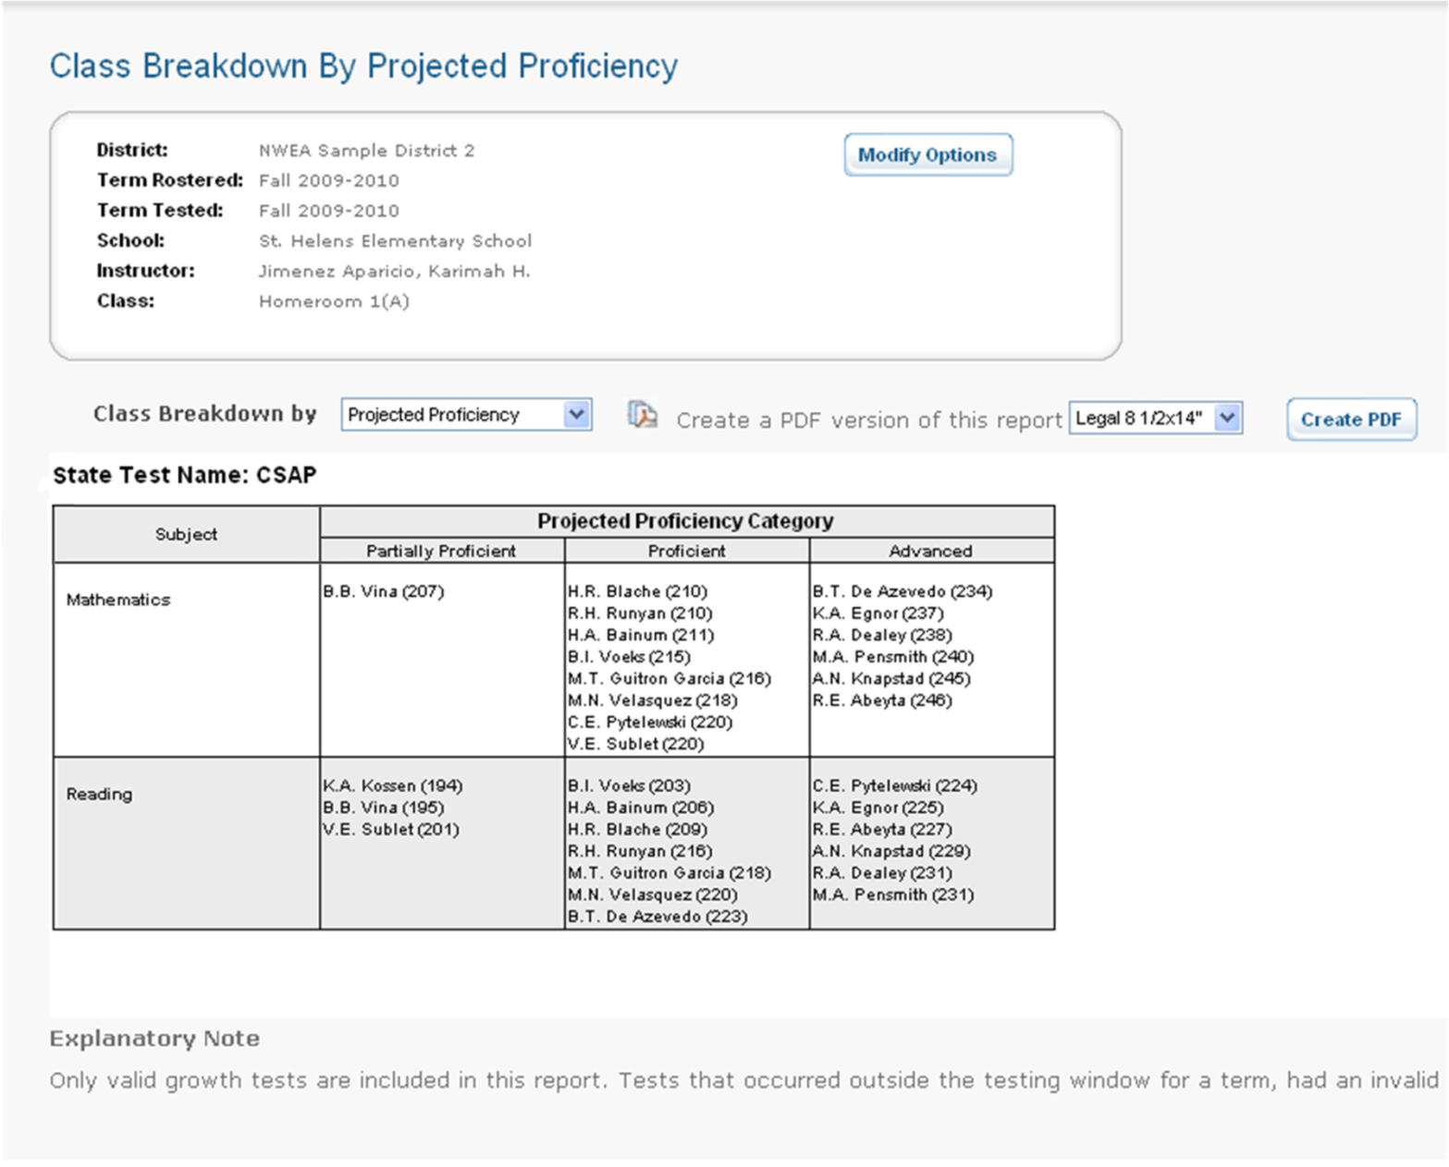
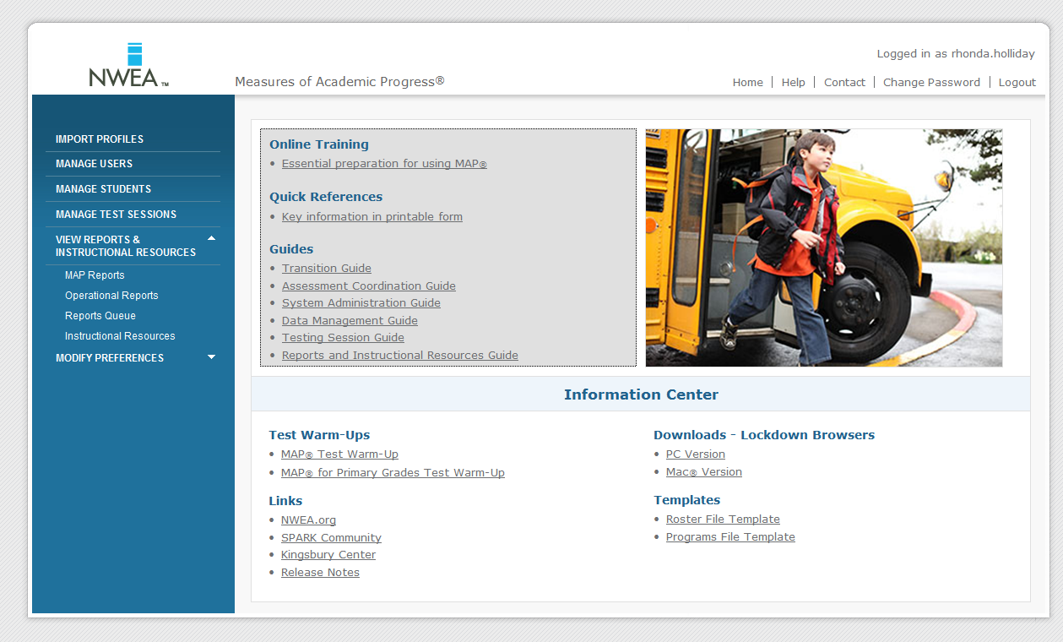
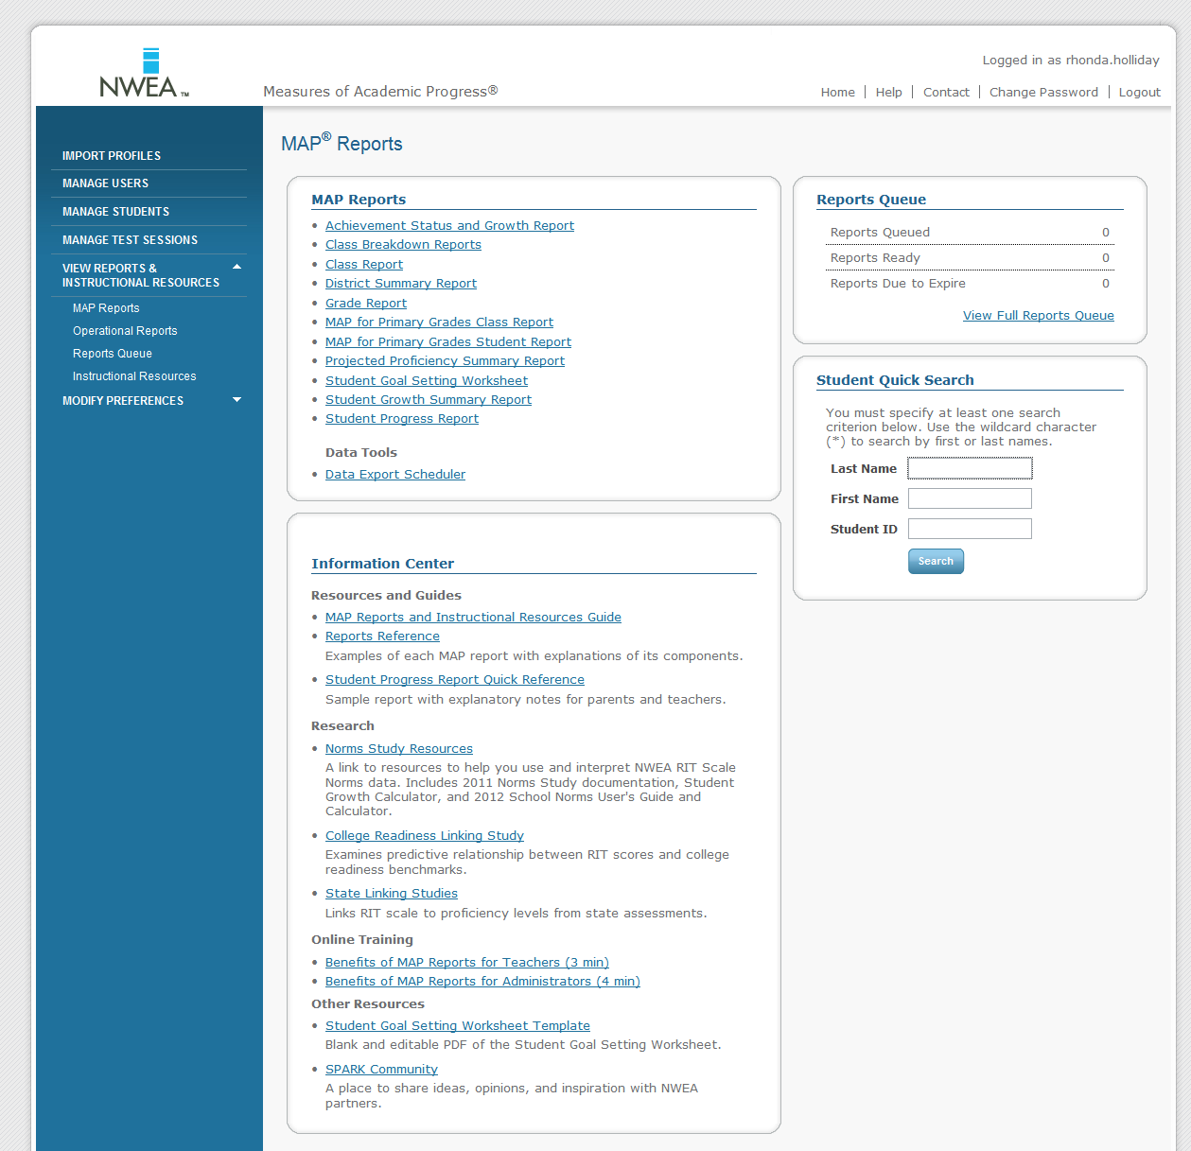
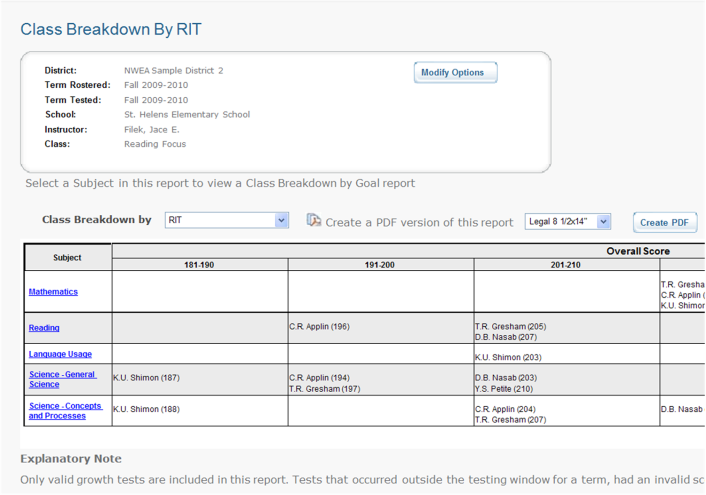
Class Breakdown Reports and DesCartes: A Continuum of Learning®
Notes:
Timing: see slide 11
Purpose:
This slide illustrates the process of accessing the Class by RIT and drilling down to Breakdown by Goal Area and DesCartes, including animations.

Slide 12
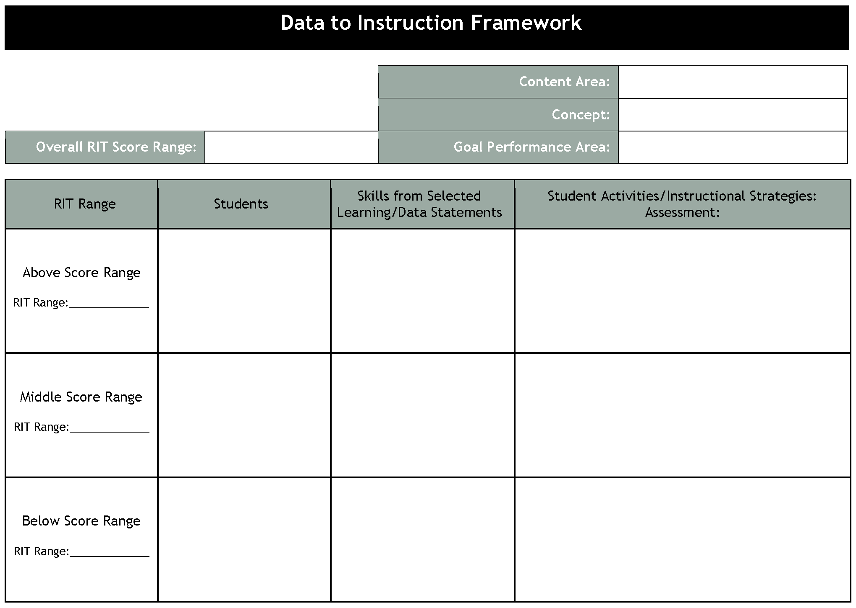
Connecting Data to Instruction
Identify a Standard/Concept
Identify related goal area
Find overall RIT range for class
Locate the middle range
Identify the ranges above and below
Choose 2-3 statements for each range
Identify activities/strategies to target skills and determine assessment to measure success
Notes:
Timing: 30 minutes
Purpose:
Connect Scores to Skills
Review Essential Reports Chart
Timing: 5 minutes
Purpose:
Review Essential Reports Chart for additional entries

Slide 13
Jigsaw Activity
Notes:
Timing: 60 minutes
5 min.: Introduce Activity
30 min.: Activity
25 min.: Share and record
Purpose: Participants access Key NWEA resources.

Slide 14
Growth Norms Bring Context to the Data
Physical Growth vs. Academic Growth
Typical Growth
Normative Data
Growth Projections
Grade 6 Reading: Fall to Spring Growth Projections
Starting RIT | 170 | 180 | 190 | 200 | 210 | 220 | 230
Mean Growth | 6 | 5 | 5 | 5 | 4 | 4 | 3
Glennisha: RIT 198
Hunter: RIT 227
Notes:
Timing: 30 minutes total; this slide and the next: 15 minutes
Purpose:
Display the differences in academic growth for the two students discussed in the ASG reports and activities. Language Usage example, fall to fall.
Participants learn to interpret and apply the ASG Projection and Summary Reports, understand how growth is calculated, and how to use this information to make instructional decisions and set goals with students.

Slide 15
Achievement Status and Growth Reports
Projection Report
Available after the first testing season
Shows realistic growth projections for all students in a class
Summary Report
Available after the second testing season
Displays data relative to the growth projections for each student
Notes:
Timing: 30 minutes total; this slide and the previous slide: 15 minutes
Purpose:
Display the differences in academic growth for the two students discussed in the ASG reports and activities. Language Usage example, fall to fall.
Participants learn to interpret and apply the ASG Projection and Summary Reports, understand how growth is calculated, and how to use this information to make instructional decisions and set goals with students.

Slide 16
Growth in Context
RIT Scale School Norms User’s Guide
The NWEA Research Team has enhanced the RIT Scale School Norms User’s Guide, which has more depth than the former School Growth Study.
The guide looks at district-level RIT scores and distributions. This added informative data for school and grade-levels will help you compare your performance to other schools around the country.
In addition to the RIT Scale School Norms User’s Guide, a calculator for accessing searchable data points within the tables and a short instructional video are available for your use. To access these resources, go to NWEA.org/schoolnormsstudy.
Notes:
Timing: 5 minutes to share information
Purpose:
displays information regarding the purpose of the guide and where participants can access additional information regarding the guide.

Slide 17
Student Goal Setting
Student
Class
Grade level
School
District
Notes:
Timing: 45 minutes total with linked slides
Purpose:
Display a sample Student Goal Setting Worksheet and highlight student strengths, areas that need strengthening, and areas for action planning.
Participants understand the goal-setting process and define goals.
Participants access, interpret, and use the Student Goal Setting Worksheet.

Slide 18
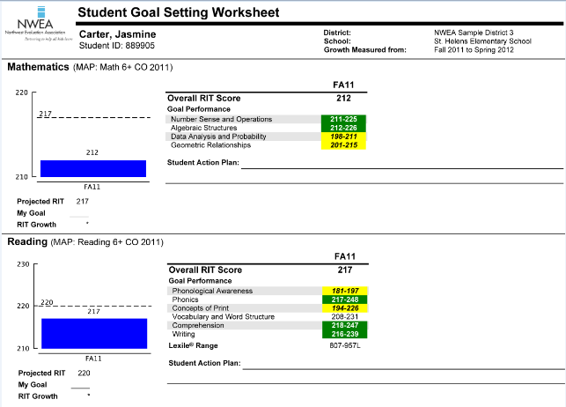
Student Goal Setting Worksheet
Notes:
Timing: 45 minutes total
Purpose:
Display a sample Student Goal Setting Worksheet and highlight student strengths, areas that need strengthening, and areas for action planning.
Participants understand the goal-setting process and define goals.
Participants access, interpret, and use the Student Goal Setting Worksheet.

Slide 19
Student Progress Reports
Displays student’s overall progress in historical terms and includes comparisons to district average and NWEA norm group average.
In text and graphical format.
Notes:
Timing: 5 minutes with linked slide
Purpose:
Participants will see a demonstration of how to access Student Progress Reports and what they look like. Participants will interpret and use data from the Student Progress Report.

Slide 20
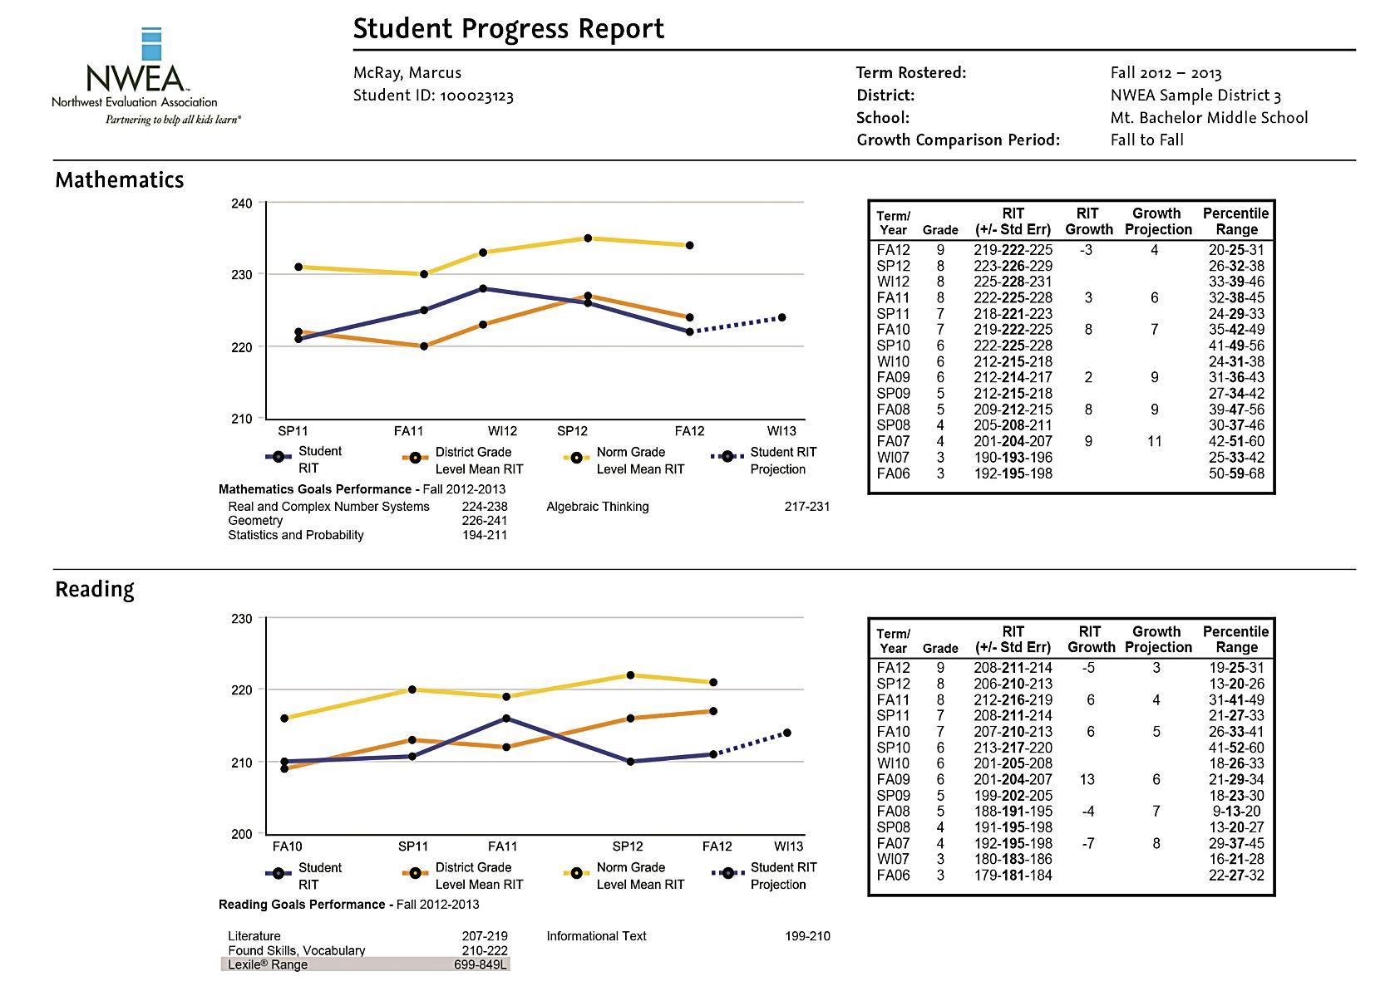
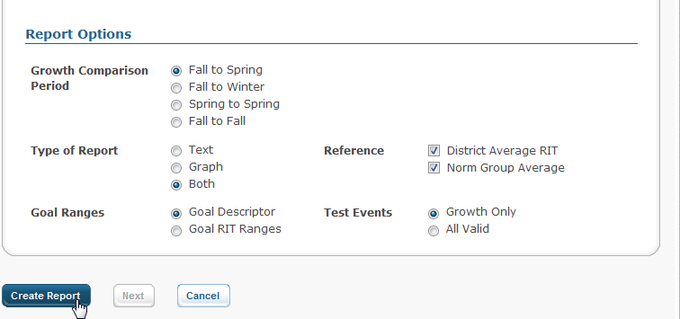
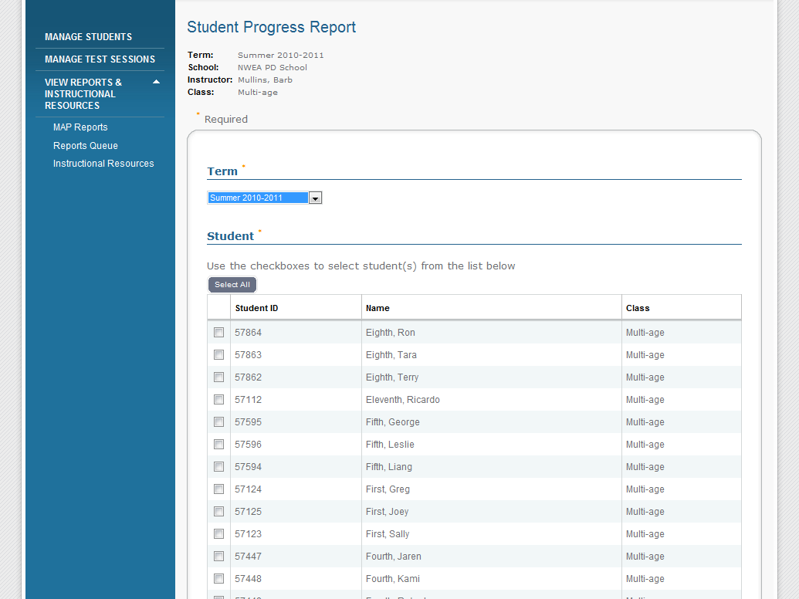
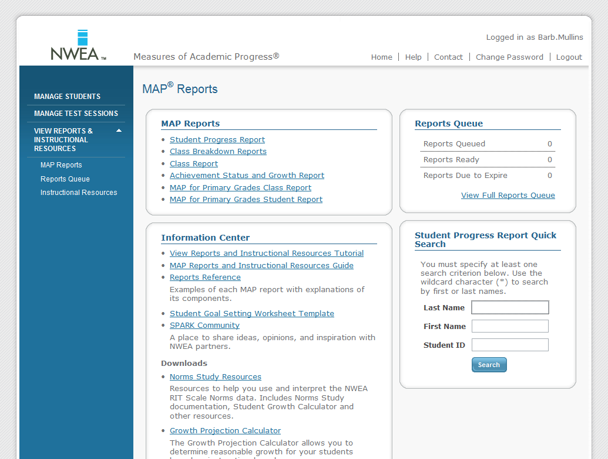
Student Progress Reports
Notes:
Timing: 5 minutes with slide 20
Purpose:
Display the process of accessing the Student Progress Reports, including animations.
Participants will see a demonstration of how to access Student Progress Reports and what they look like. Participants will interpret and use data from the Student Progress Report.

Slide 21
Sharing Results
Students
Student Progress Report
Student Goal Setting Worksheet
With individual students
As a class activity
Parents
Student Progress Report
Student Goal Setting Worksheet
DesCartes/Primary Grades Instructional Data
Notes:
Timing: 30 minutes with next slide
Purpose:
Participant role-plays discussing goals with students. See next slide for role-play for discussing goals with parents.

Slide 22
Possible Parent Questions
Has my child’s score gone up?
Is my child performing at grade level?
Based on these scores, how and what will you teach my child in class?
What do the percentiles mean?
Notes:
Timing: 30 minutes with previous slide plus 10 minutes; see below
Purpose:
Participants role-plays for discussing goals with parents and see possible questions for use during role-play. See previous slide for participant role-plays discussing goals with students.

Slide 23
Planning Forward
Example
WHAT will you do with the information you learned today? | HOW will you approach implementation? | WHO will be involved? | WHEN will you try it?
I would like to use MAP data to motivate my students to improve. | I am going to implement goal setting with my students. | My grade-level partners, parents, and students. | Between now and spring assessment.
Notes:
Timing: 5 minutes
Purpose:
Review previous work using the Essential Reports Chart for reference during Planning Forward activity.
Timing: 5 minutes
Purpose:
Start Planning Forward commitments.
Timing: 5 minutes
Purpose:
Synthesize plans.

Slide 24
Today’s Learning: Exit Ticket
What worked for you in this session?
What will you change as a result of your learning today?
What are you wondering?
What do you need now?
Notes:
Timing: 15 minutes, this slide and the next
Purpose:
Participants reflect on their learning and self-assess their knowledge and skills. (Consider a separate slide for this. This slide takes people to the "I'm leaving now" space and may detract from self-assessment.)
Participants provide feedback about the workshop, their learning, current questions, and needs.

Slide 25
Thank you for your attention and hard work.
Help Us Learn from You
Facilitator:
Workshop:
Notes:
Timing: 15 minutes, this slide and the previous slide
Purpose:
Thank participants.

Slide 26
The MAP® Adaptive Assessment
Adult Reading
MAP Test
x
x
x
x
x
x
x
6th Grade
x
x
-
x
x
x
-
x
x
-
-
-
-
x
+
+
+
195
+
+
Beginning Literacy
Notes:
Purpose:
Describe how MAP measures the student’s level along a learning continuum
Background Information:
This example looks at what happens in a single goal strand when a 6th grade student sits down at the computer for the first time. The initial item will be at the mean difficulty level for that grade level. From here on out, the computer will select items specifically for the student depending on how he or she performs on all of the previous items in that goal strand.
The student here misses the first item. The test will select an easier item the next time it visits this goal strand and displays it on the screen.
The student misses the second item as well. Based on the student’s two responses so far, the computer will display another easier item.
The student misses this one too. Based on the student’s three responses so far, the test chooses another, easier item.
Each time the student answers a question, the test scores all the items taken so far to select the next item.
The test will continue to select questions, cycling through the goal strands, until the student reaches the end of the test.
The score is immediately available to the student and teacher. In this example, the 6th grade student’s overall RIT score is 195.

Slide 27
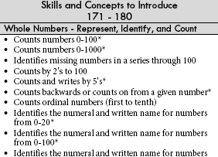
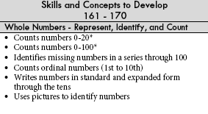
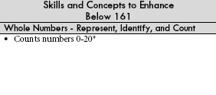
Rasch unIT (RIT) Scale
Achievement scale is an equal-interval scale
Used to show growth over time
Independent of grade level
Grade-Level
Norms
RIT
Skills Data
250
DesCartes or Primary Grades Instructional Data
10
9
8
7
7
6
6
5
4
3
2
1
K
120
Notes:
Purpose:
Introduction of the RIT scale
Background Information:
The RIT scale is short for the Rasch unIT scale.
The RIT scale is an equal-interval scale, like a yardstick. This means that 10 RIT points at the bottom of the scale equals 10 RIT points at the top.
The RIT scale lets us see growth occurring between beginning-of-year and end-of-year test events and across time.
The scale is consistent; it has the same meaning, regardless of the students’ grade levels.
Scores are aligned to the RIT scale to help us see students’ learning readiness.
RIT scores will also help us to demonstrate student growth over time.
The RIT scale aligns both to performance norms (typical grade-level performance) and content and skills found in DesCartes, or in the case of MAP for Primary Grades, in Primary Grades Instructional Data. These skills are presented on a continuum of increasing difficulty and complexity.
The star on the slide might represent a student in a sixth grade classroom.
The RIT score helps his teacher to see that his learning readiness is more like that of a third-grader. But more importantly, it aligns with DesCartes to indicate skills and concepts appropriate for his instructional needs.

Slide 28
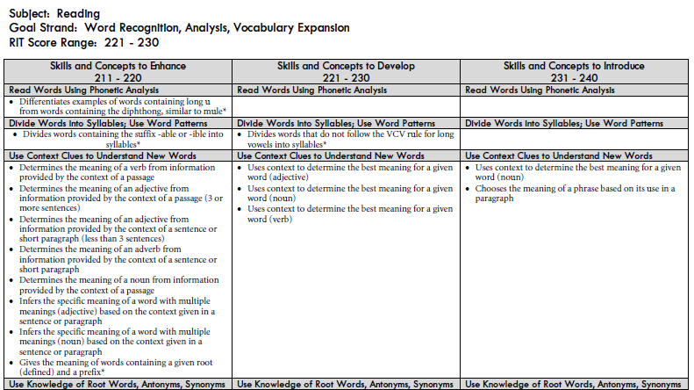
Measuring Growth
221-230
Notes:
Purpose:
Illustrate the connection between progress on the RIT scale and progress on DesCartes, as well as how that progress is connected to progress on state standards.

Slide 29
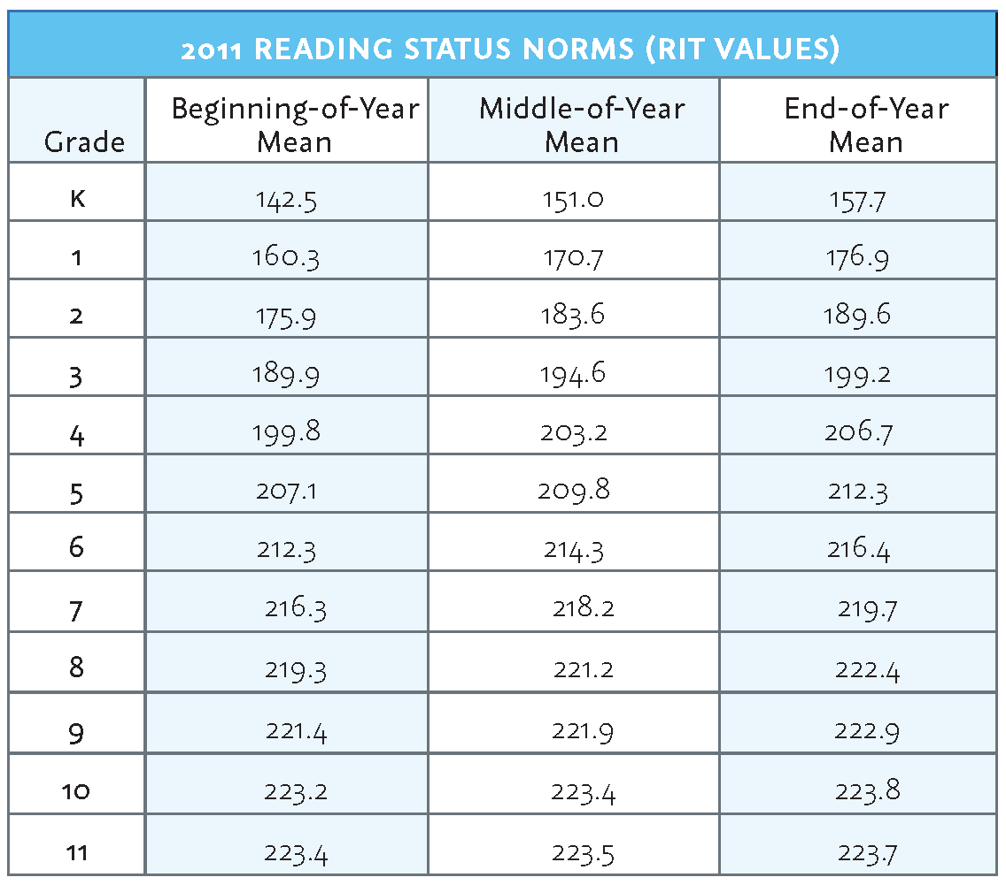
Normative Data: Bringing Context to the Data
Grade-level norms
Typical performance
Beginning-of-Year, Middle-of-Year, and End-of-Year
Notes:
Purpose:
Review the purpose for referring to the Normative Data handout when examining student data.
Background Information:
The Normative Data document connects the scores you see represented on your reports to those of a larger group.
NWEA completes and releases a new RIT Scale Norms Study every three years.
If groups would like to role-play this, ask for volunteers to share the discussion.

Slide 30
NWEA™ Research
typical
What are expected RIT and growth scores?
Normative Data, grades K-10
Scale Alignment Studies
Aligns RIT scale with state proficiency benchmarks
NWEA Goal Structures
Notes:
Purpose:
Understand that the data from the norm group provides information we need to begin to make meaning out of our scores.
Learn that the Kingsbury Center, NWEA’s independent research institute, provides state testing studies that link the NWEA assessment scale to state proficiency levels.
Point out that NWEA Goal Structures connect the content from state standards to each reporting area of state-aligned MAP tests.
*Use the Progress and State Standards link if they have specific questions or want clarity about how this concept works.
Background Information:
NWEA completes a norming study every three years.
These studies provide a reasonable way to compare the performance of a single student, class, or grade to a larger, more meaningful group.
The NWEA RIT Scale Norms Study includes more than two million students from a wide variety of schools throughout the nation.
The Normative Data document contains five tables: Language Usage, Reading, Mathematics, General Science, and Science Concepts.
The tables show Beginning-of-Year, Middle-of-Year, and End-of-Year mean scores for each grade level.
Mean score represents the average score of the
These scores are not expectations or stopping points, merely an indication of the how each grade level group performed.
Educators can use the norms to help determine what is the “typical” 50th percentile score for students in a particular grade level in the norm study.
Recommend the use of the word “typical” by teachers and administrators when talking about norms. Avoid using “expected” or “should be” since we wish to treat each student as an individual.
Norms are to be used simply as a point of reference.
“Typical” performance for a district may be different than the NWEA norms.
Remember that most students are not “typical” and therefore, NWEA will provide you with individual growth projections based on students’ starting points.
The Kingsbury Center, NWEA’s independent research institute, conducts Scale Alignment Studies for many states which link NWEA assessment data to state assessments and proficiency benchmarks. These studies can be found at the NWEA web site under the Our Research tab.
Goal Structures connect the content from state standards to each reporting area of state-aligned MAP tests. Using NWEA Goal Structures, the concepts in Class Reports may be directly connected to each state’s unique standards as well as to DesCartes learning statements.
MAP for Primary Grades assessments are aligned to the goal structures from various professional organizations, e.g., National Council of Teachers of Mathematics, International Reading Association.
Be prepared to talk about growth information if asked. Growth information can be found in the NWEA RIT Scale Norms Study, which can be accessed from the Norms Study Resources page after logging into the Reports Site or MARC. Growth projections can be calculated using the Achievement Status and Growth (ASG) Calculator which is also available from this page.
Check ahead of time to find out if the state you are going to has a Scale Alignment Study.

Slide 31
Instructional Level vs. Mastery
The MAP test:
Provides information about the instructional level of the student.
Provides a road map for students toward achieving mastery.
Is not a test for determining mastery of skills.
Notes:
Purpose:
Introduce instructional level
Become aware of your own thinking and reasoning around instructional level data
Background Information:
MAP assessments provide the instructional level of the student.
With MAP assessments, our purpose is to get the most accurate information we can on every child, regardless of where they are in the curriculum. In order to do this, we had to design something different. MAP assessments provide teachers with the instructional level of the student.
MAP tests are based on a continuum of skills in mathematics, reading, language usage, and science from low knowledge skill levels to high levels. We can consider them to be one long test in a particular subject, rather than a series of shorter tests that assess students over specific criteria at various grade levels.
It provides a way–a road map–for determining where each student is performing in relation to local or state standards, curriculum, or other criteria. This road map is similar to mile markers along a highway that are used as one travels from one destination to another.
Just as we follow mile markers to help us travel, the MAP tests provide us with similar mile markers, which we can use to continue to monitor students’ progress along the continuum of skills toward mastery.
It’s important to remember that MAP assessments are not mastery tests; they show us the instructional or learning level of the student.

Slide 32
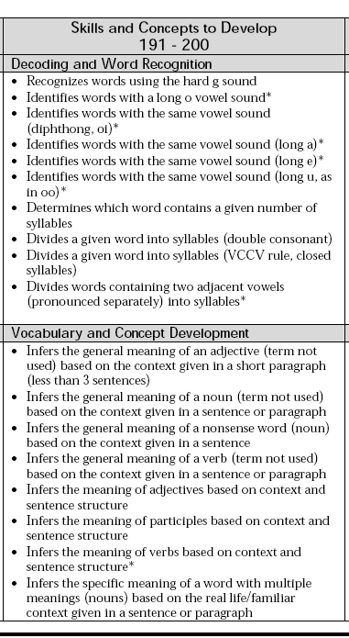
Ready for Instruction Today
Ready for
Instruction
Today
RIT
Skills and Concepts
250
DesCartes or Primary Grades Instructional Data
195
120
Notes:
Purpose:
Confirm understanding of the RIT scale
Background Information:
You may find it meaningful and memorable to connect the acronym R-I-T to the phrase Ready for Instruction Today, which indicates a student’s readiness to learn at the particular entry point indicated along the continuum of skills and concepts presented by DesCartes/Primary Grades Instructional Data.
In our previous example, the 6th grade student’s entry point along the continuum of skills and concepts was an overall RIT score of 195.
That overall RIT score indicates a student’s instructional level, or readiness to learn.
When we examine DesCartes/Primary Grades Instructional Data we’ll find indicators of the best point of entry for this student along the achievement scale.
DesCartes learning statements and Primary Grades Instructional Data statements pinpoint the skills and concepts the student is likely to be ready to learn effectively.
On the previous slide, the 6th grader’s overall RIT score of 195, indicates this student is ready to learn skills and concepts in DesCartes within the 191-200 range.
At what grade level is this student performing most like based on normative data?

Slide 33
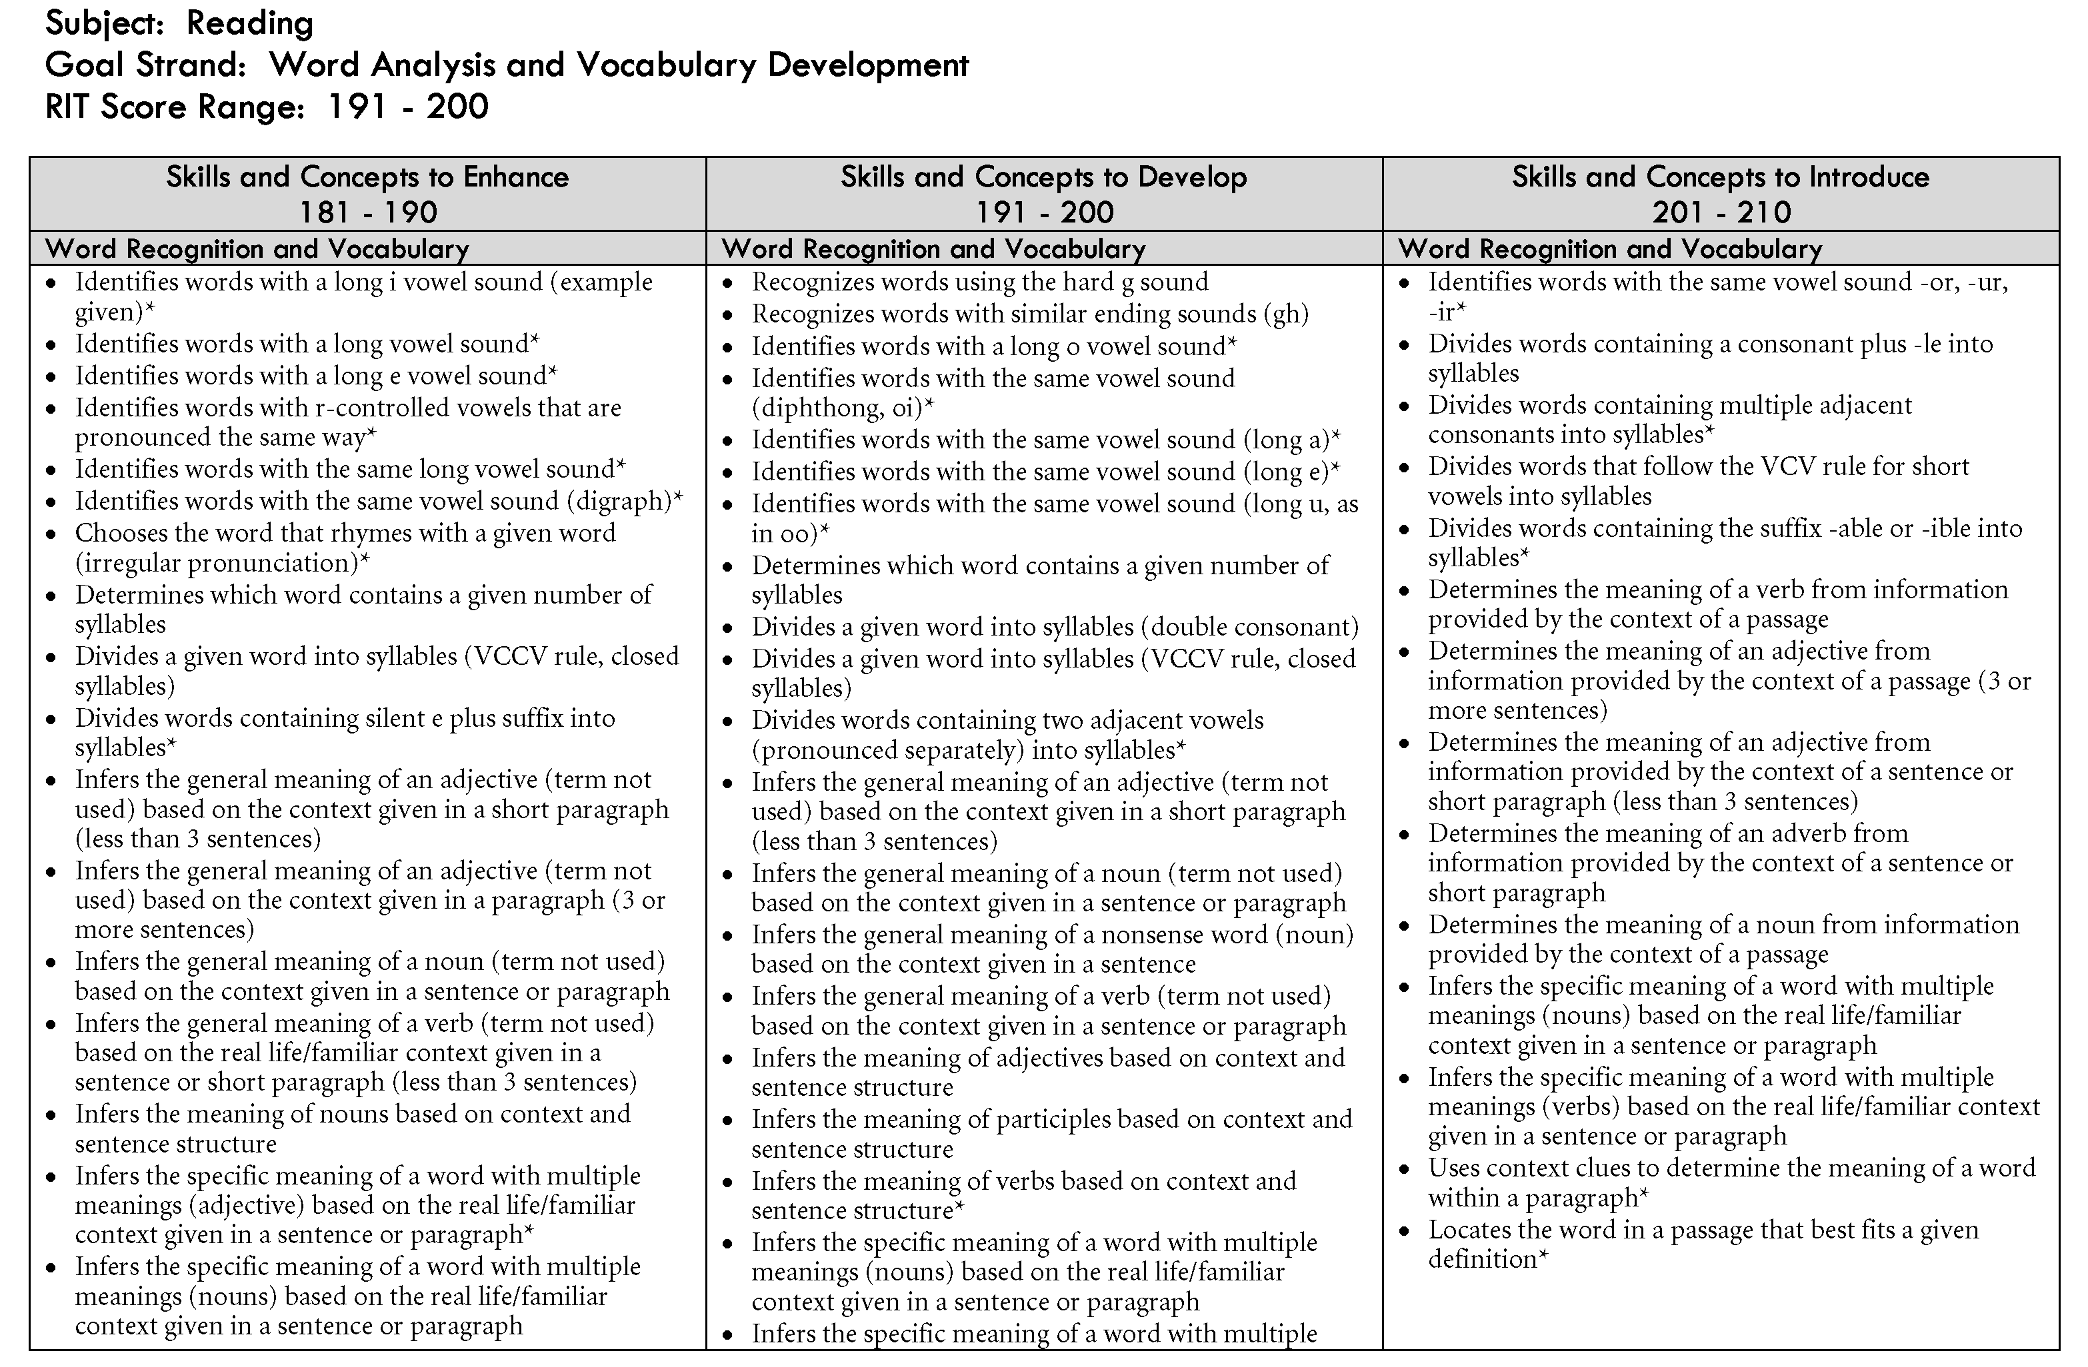
DesCartes: A Continuum of Learning®
Notes:
Purpose:
Introduce DesCartes: A Continuum of Learning and Primary Grades Instructional Data
Become aware of how these are linked to RIT scores
Background Information:
DesCartes is a resource for teachers to use to help determine appropriate instruction for students. It contains separate sections for each subject (mathematics, reading, language usage, and science) and is broken down into ten-point RIT bands. Within each band are sub-categories which break down the skills and concepts found in the items in the MAP test.
The example shown here is from reading in the goal strand of Word Analysis and Vocabulary Development and the 191-200 RIT range. The center column shows skills and concepts that a student is ready to work on. The column to the left shows skills and concepts a student probably has a good command of, and the column to the right shows skills and concepts to introduce to a student when the appropriate groundwork has been laid.

Slide 34
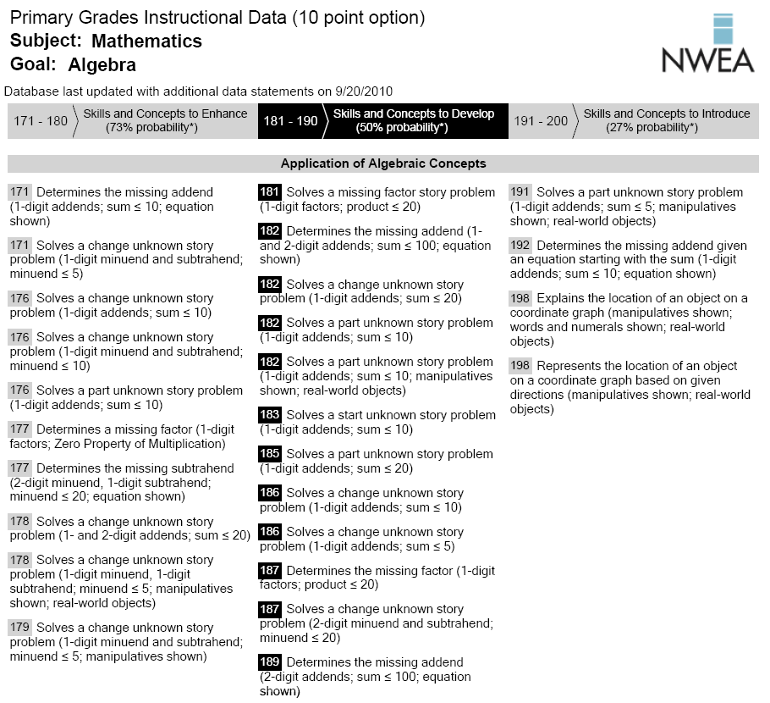
Primary Grades Instructional Data
Notes:
Purpose:
Introduce Primary Grades Instructional Data (PGID)
Become aware of how these are linked to RIT scores
Background Information:
PGID is a resource for teachers to use to help determine appropriate instruction for students. It contains separate sections for each subject (mathematics and reading) and is broken down into five or ten-point RIT bands. Within each band are sub-categories which break down the skills and concepts found in the items in the MPG Survey with Goals test.
The example shown here is from mathematics in the goal strand of Algebra and the 181-190 RIT range. The center column shows skills and concepts that a student is ready to work on. The column to the left shows skills and concepts a student probably has a good command of, and the column to the right shows skills and concepts to introduce to a student when the appropriate groundwork has been laid.

